Slide 1

Development of an Open-source Step Counting Algorithm
Hankertrix
Student
School of Mechanical and Aerospace Engineering
21/04/2025

Slide 2
Motivation for research
Proprietary algorithms are expensive and perform poorly
Existing open-sourced algorithms are not accurate and can be cheated
Accurate ones are computationally expensive
Steps become poor indication of physical activity for healthcare research

Slide 3
Literature Review
Sensor-based techniques
Optical techniques
Accelerometer-based techniuqes

Slide 4
Sensor-based techniques
Pressure sensors or foot switches
Good accuracy of 94.8% to 99%
Studies have short durations or used small predefined number of steps
Require specialised hardware and are not cheap to install

Slide 5
Optical techniques
Video feed to count steps using markers
Good accuracy of 99.4% and above
Needs human intervention to select the markers
Only useful in lab setttings and on a treadmill

Slide 6
Accelerometer-based techniques
Different accelerometer positions
Different algorithms

Slide 7
Accelerometer positions
Wrist, waist, thigh, ankle
Waist is most accurate, while wrist is least accurate
Wrist is most common, easier to collect data for
Wrist data is more representative as it is less likely to affect behaviour

Slide 8
Algorithms
Peak finding
Continuous wavelet transforms
Machine learning
All algorithms use the magnitude of acceleration

Slide 9
Acceleration magnitude formula
Where:
|a| is the magnitude of the acceleration
x, y, z are the accelerations in the respective directions.

Slide 10
Peak finding algorithms
Ducharme’s acceleration threshold algorithm (97% wrist, 90% waist)
Oxford step counter (41% slow, 84% fast)
Verisense algorithm, uses GGIR R package to detect downtime (92.1%)

Slide 11
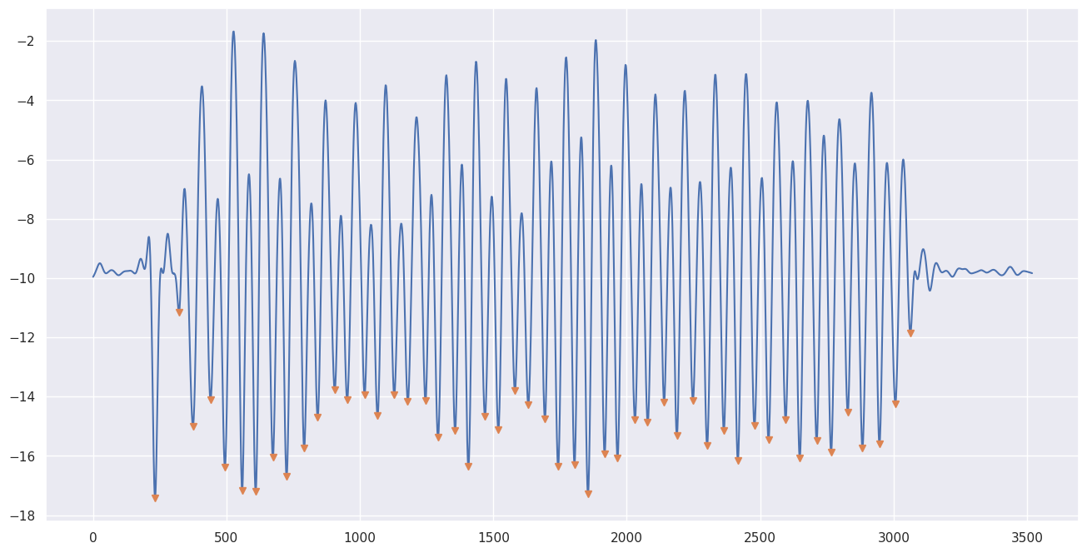
Peak finding algorithms

Slide 12
Continuous wavelet transform algorithms
Straczkiewicz’s algorithm (99%)
ADEPT (95.51% wrist, 99.25% hip)

Slide 13
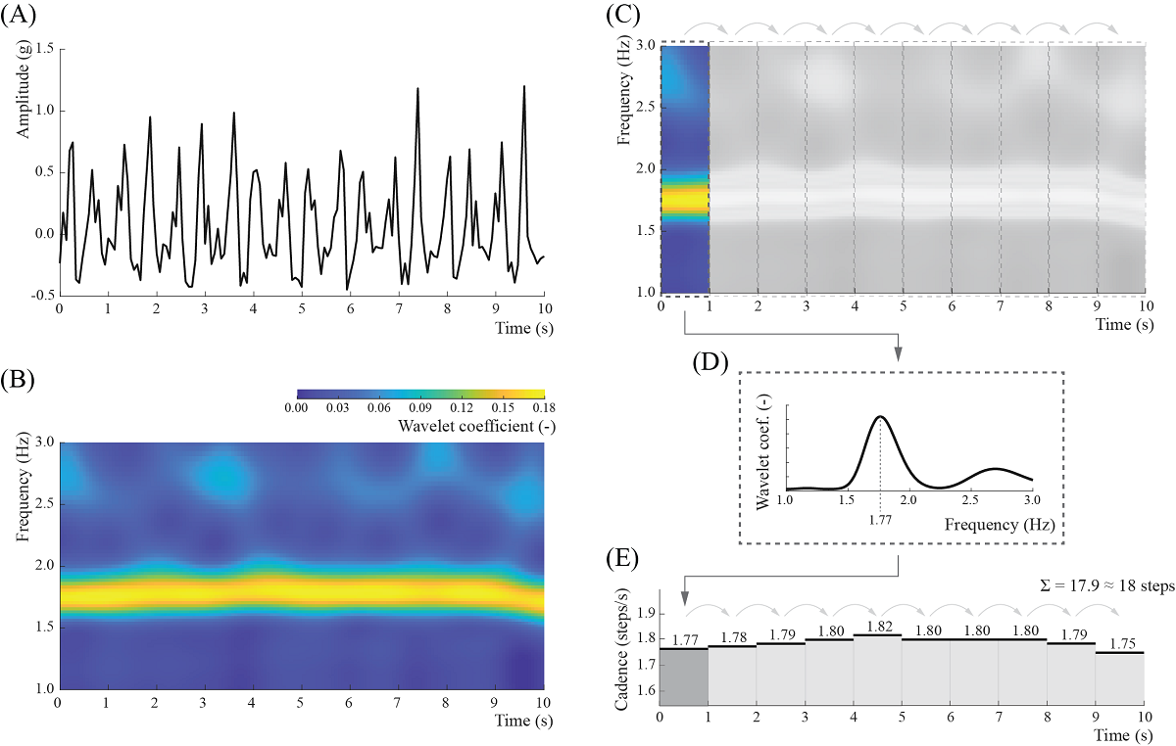
Straczkiewicz’s algorithm

Slide 14
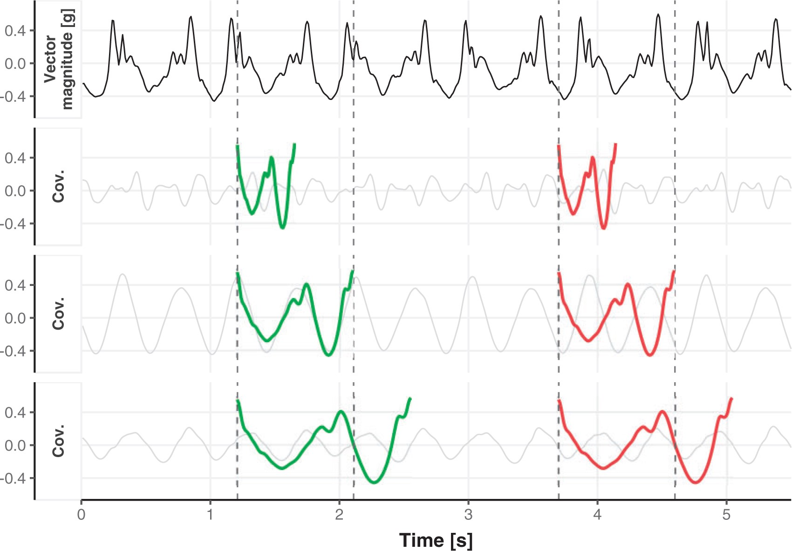
ADEPT

Slide 15
Machine learning algorithm
ResNet V2 neural network trained on UK Biobank for human activity recognition
Trained on Oxwalk data set for gait patterns
Peak finding to count walked steps
98.3% accurate, best algorithm for free-living situations

Slide 16
Research gaps
Only triaxial accelerometer data
Did not account for different gait patterns, save for the machine learning algorithm
Did not account for cheated steps
Increasingly abstract and computationally expensive; less explainable

Slide 17
Scope
Literature review
Collection of data
Development of algorithm

Slide 18
Research methodology
Collect preliminary data
Understand the acceleration data and how it relates to movements
Develop step-counting algorithm

Slide 19
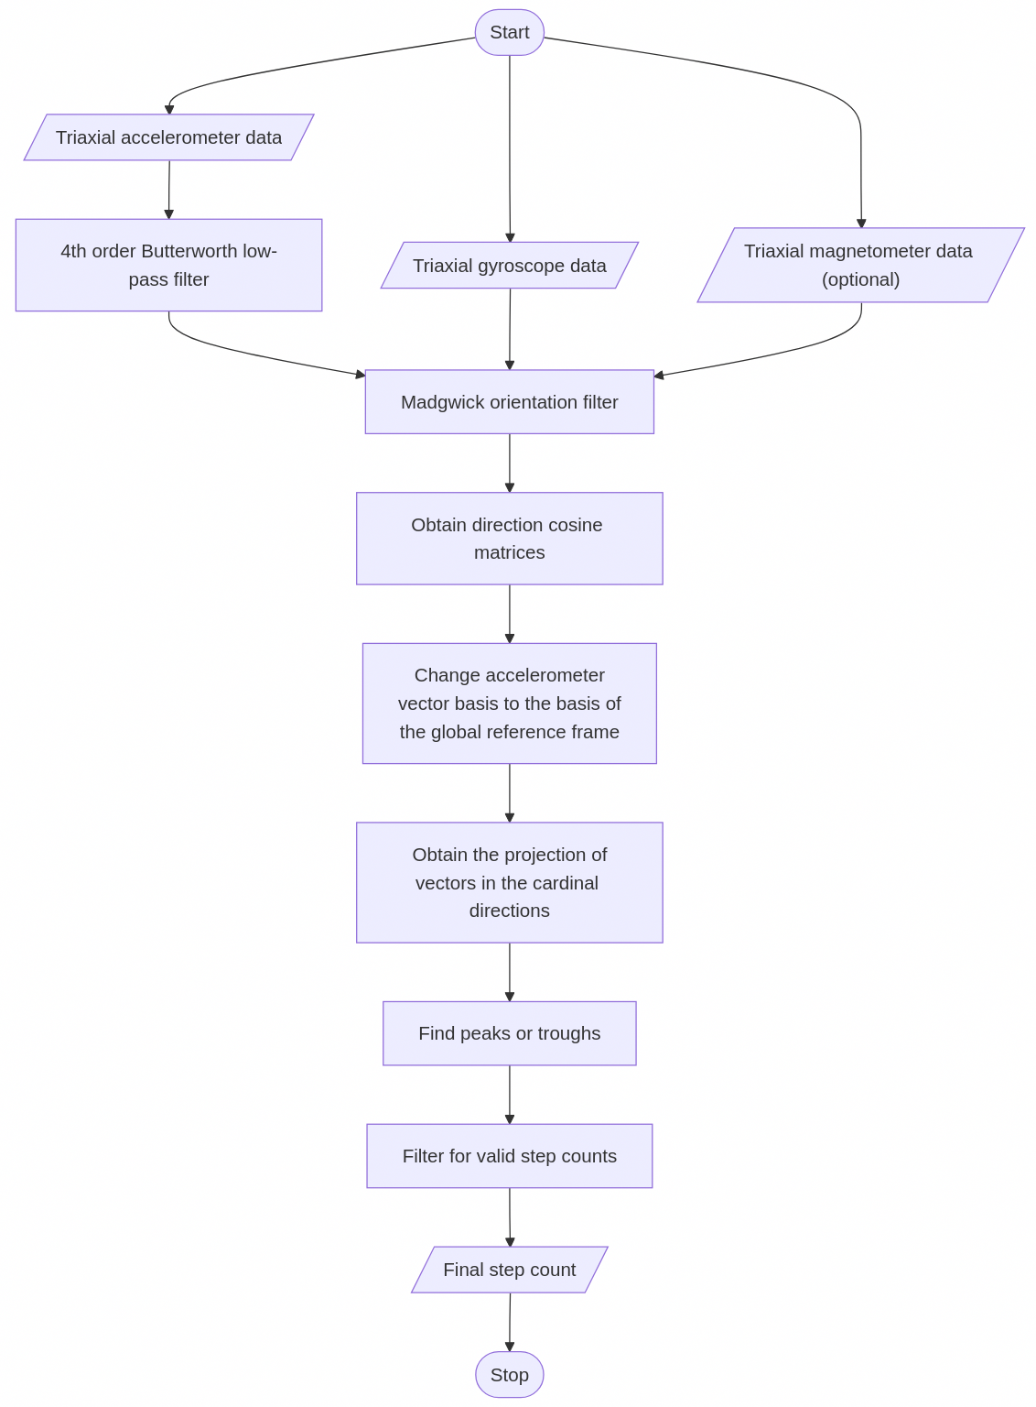

Slide 20
Procedure for data collection
WitMotion WT901BLECL 9-DOF IMU
100Hz sampling frequency
Accelerometer is mounted on the wrist
Recording begins right before the first step and ends right after the last step

Slide 21

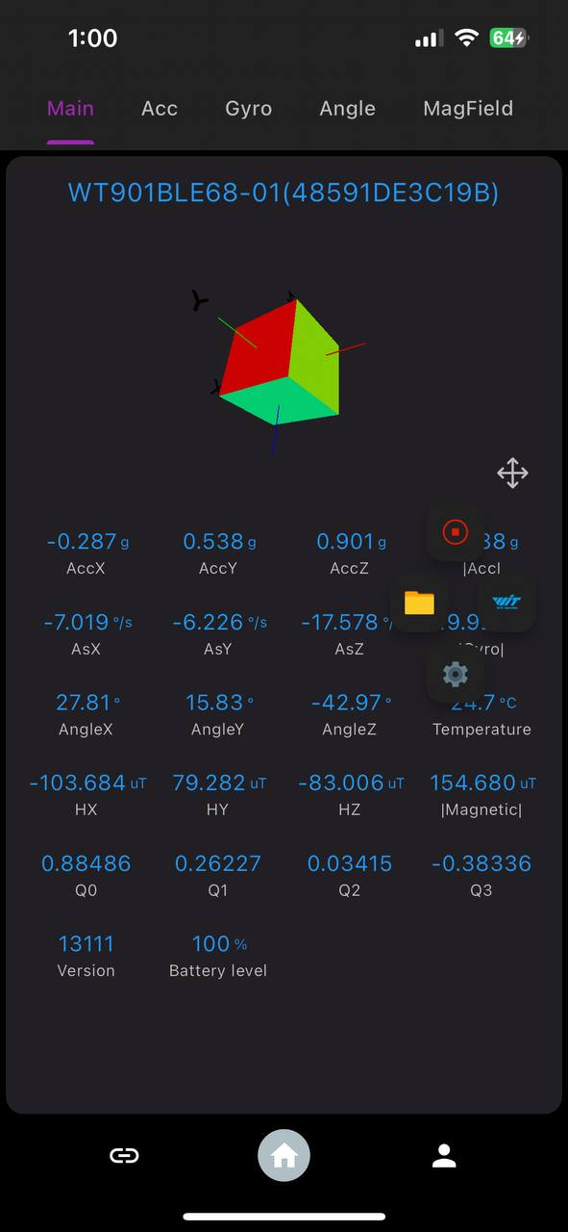
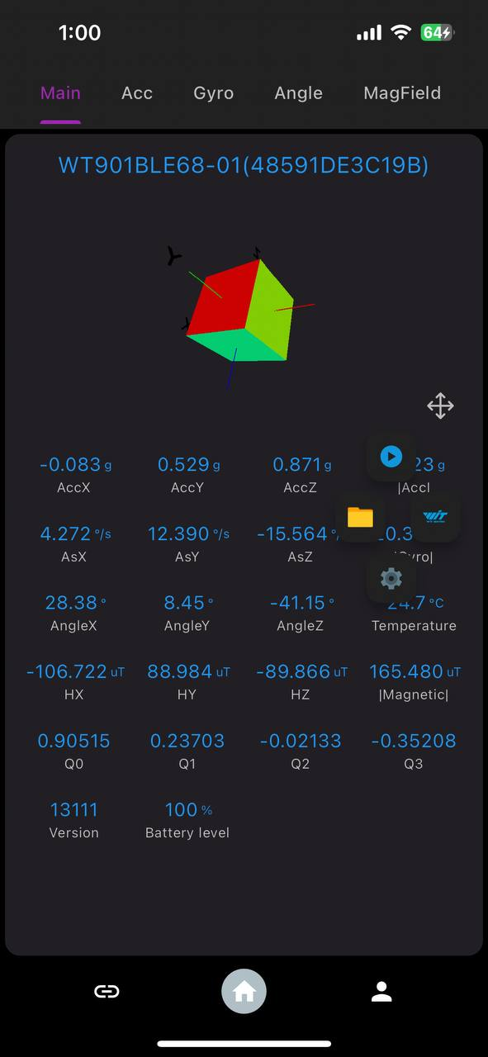
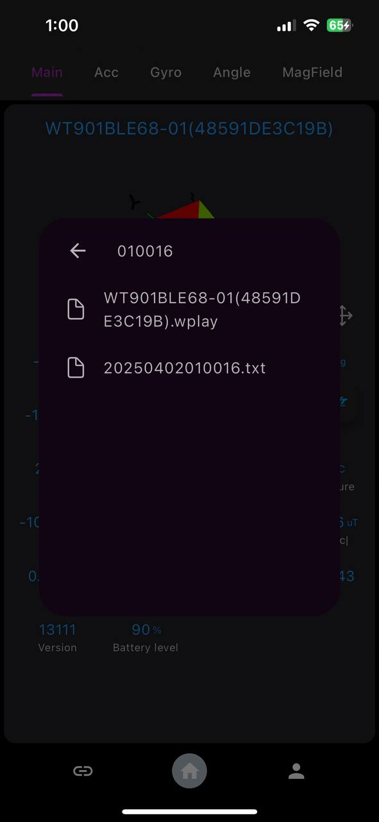
App interface

Slide 22
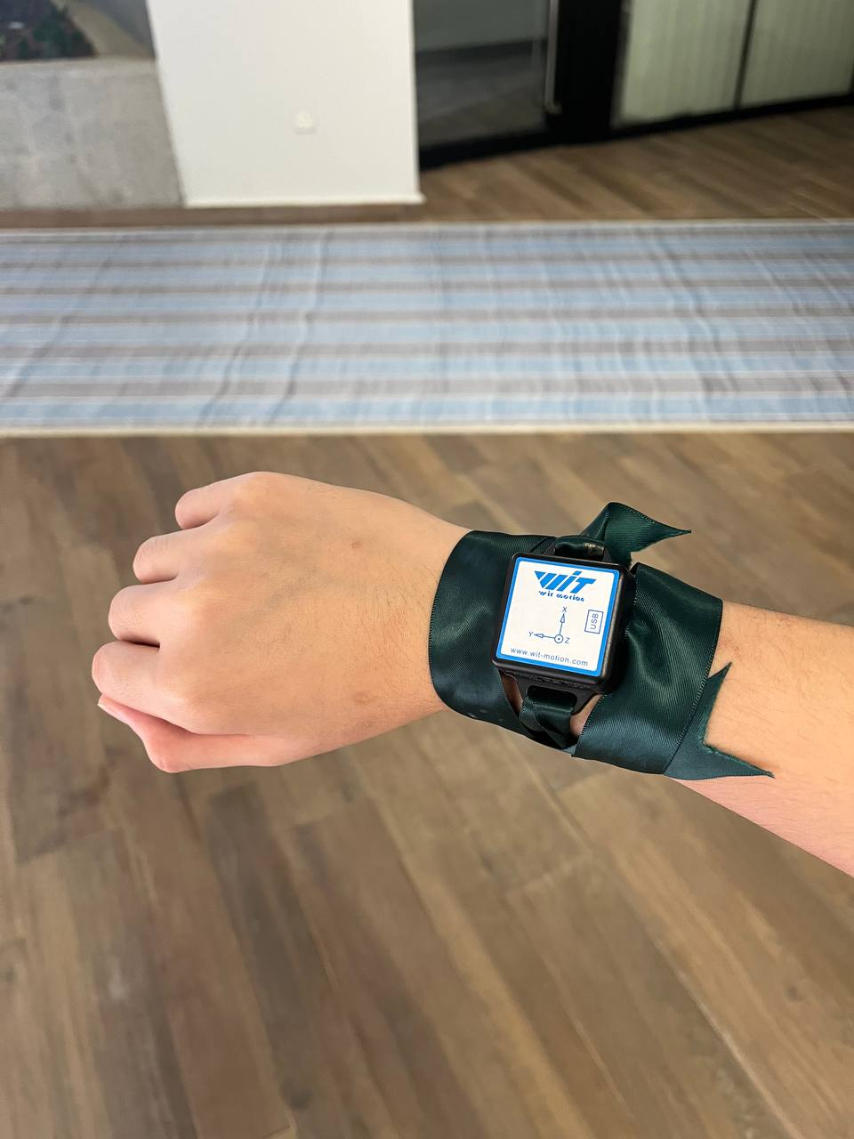
Accelerometer mounting

Slide 23







Locations

Slide 24
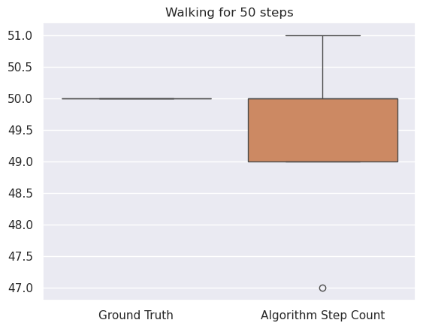
Results

Slide 25
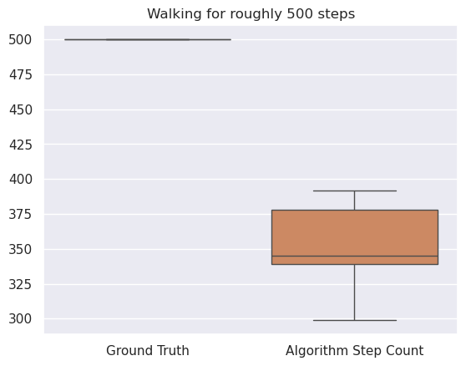
Results

Slide 26
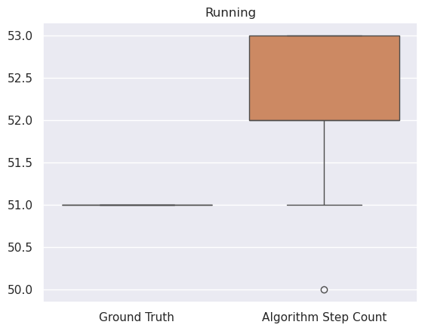
Results

Slide 27
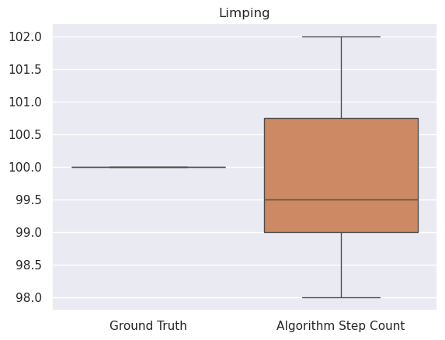
Results

Slide 28
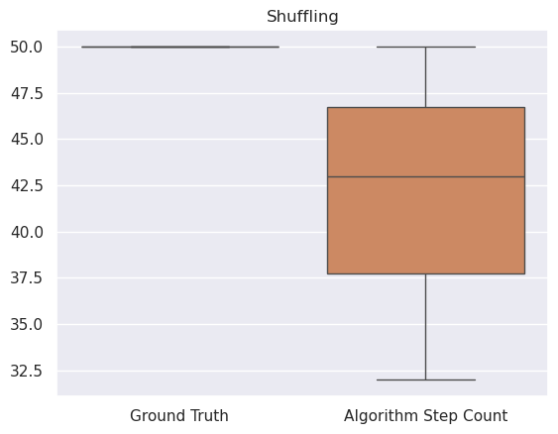
Results

Slide 29
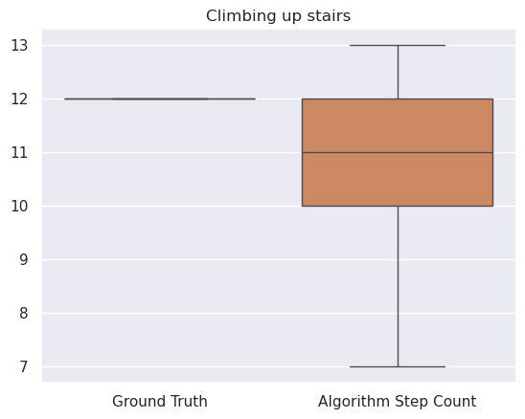
Results

Slide 30
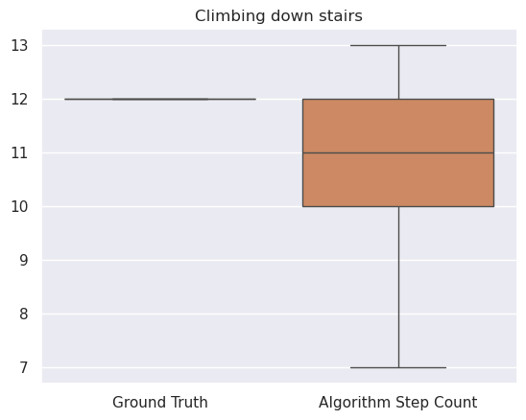
Results

Slide 31
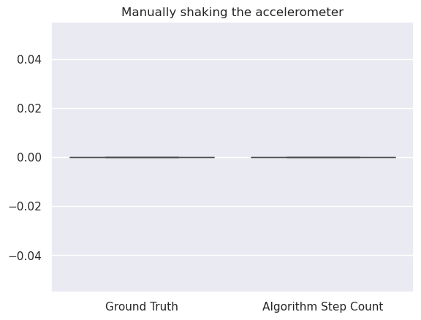
Results

Slide 32
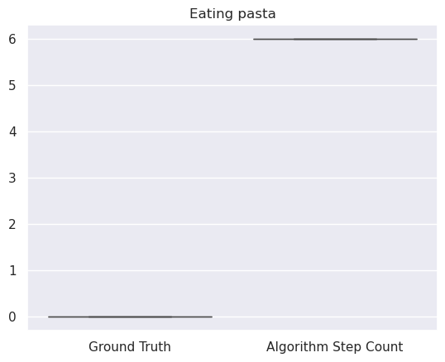
Results

Slide 33
Results
Algorithm is relatively accurate for short bursts of walking, running and limping (94%)
Accuracy is greatly reduced for shuffling (64%) and climbing stairs (50%)
Similar occurrence for longer periods of walking (60%)

Slide 34
Explanation
Shuffling has no well-defined steps
Uneven step duration
Results in missing or tiny acceleration spike that isn’t picked up
Acceleration spike due to the first foot lifting up is neutralised by accleration dip by second foot being placed down

Slide 35
Discussion
Data is self-collected, only representative of a single individual
Does not work well with fast stepping speeds or short stepping durations
Does not consider accelerations in other directions
Data collected is not granular

Slide 36
Future work
Implementation in C/C++ or Rust
Collect more 6-DOF or 9-DOF IMU data
Further exploration of the other two accelerometer directions
Map accelerometer frequencies to human actions to improve understanding
Results in better heuristics and better tuning

